Slide 1



An innovative practical approach to research
methods teaching addressing the open-science
debate
Dr Heather Cleland Woods

Slide 2
Level 1 Psychology @ Glasgow
Large class size
2016-17 = ~ 550
Teaching rankings – top 20 UK and top 50 global tables
REF – 44% of research classed as world-leading
Diverse student body – 15% classed as non-white, 30% as European/International
23% of our students come form the 40% most deprived postcodes in Scotland

Slide 3
Time to rethink our approach
Student feedback suggested repetition between years
Staff feedback suggested limited understanding of key concepts
Call for us to review our level 1 teaching of research methods
Integrate free and open source data analysis software
Innovation is key – take a wider view of skills
Research led teaching – play to strengths

Slide 4
Consistency
Student feedback suggested repetition between years
Pre-honours was focused on inferential statistics
Covered basic statistics in both years > repetition
Needed explicit skill development over semester and year
All labs composed of 3 themes:
Data
Portfolio
Communication/Interpretation

Slide 5
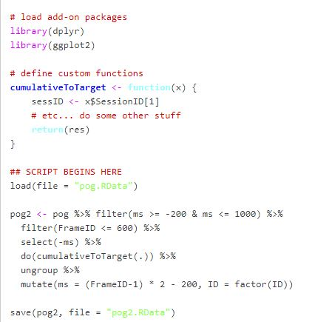
R Studio – open access analysis
Move away from inferential statistics
Data management and visualisation
Realistic data rather than canned and tidy
Focus on becoming confident and competent with data

Slide 6
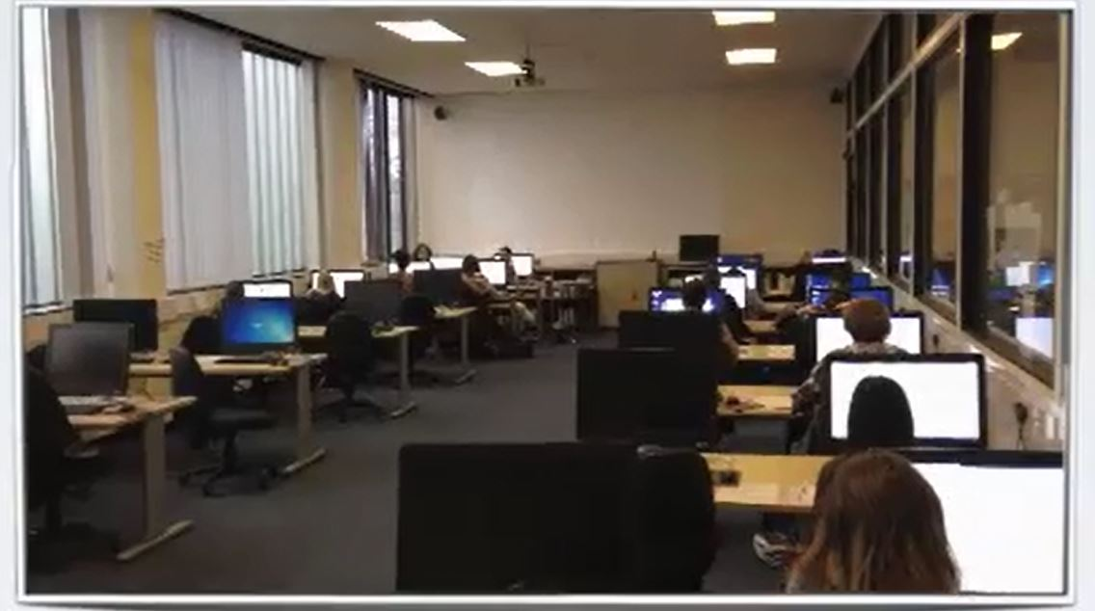
Individual work to group activities
Group work dominated labs from first class
Working through tasks with peers
Moved away from quiet labs with students working on tasks individually

Slide 7
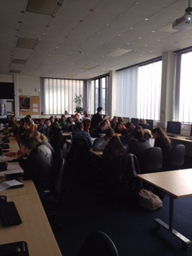
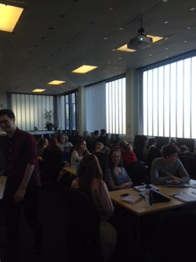
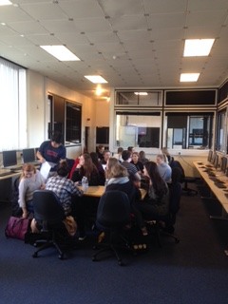
Busy noisy labs with lots of discussion!

Slide 8
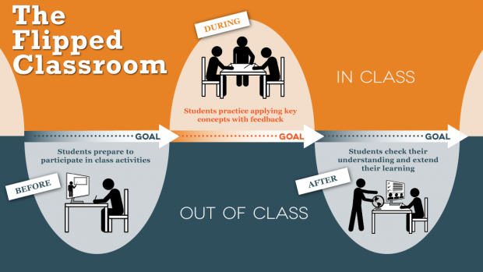
Flipped classroom

Slide 9
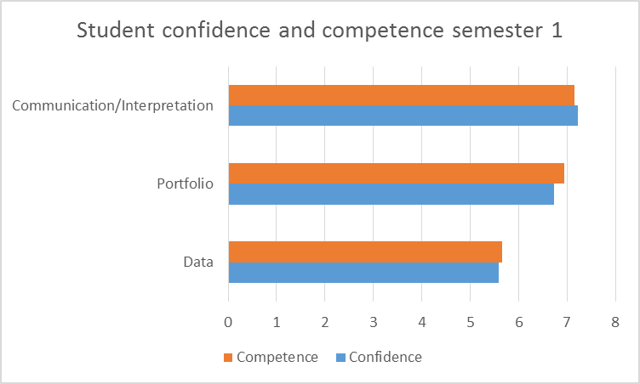
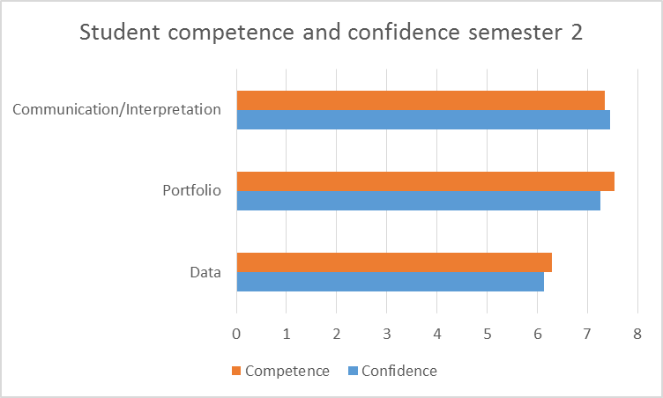
Student competence and confidence

Slide 10
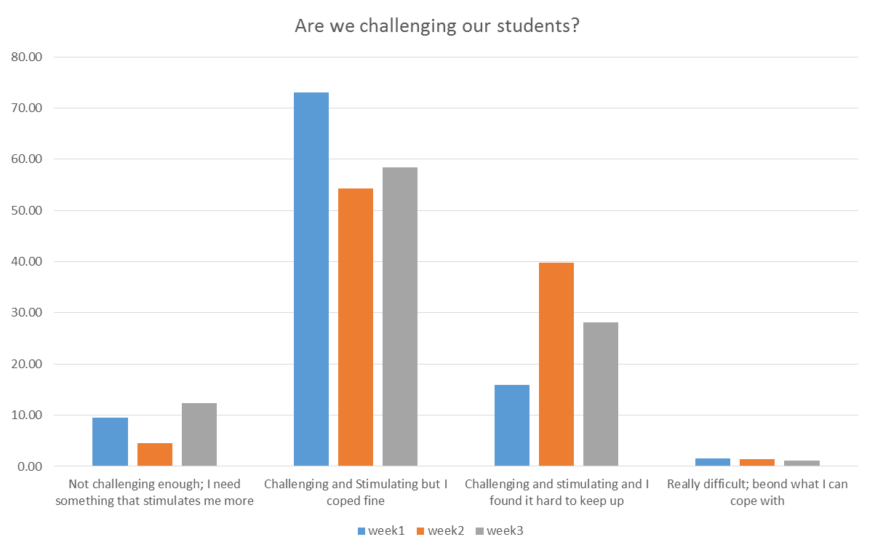
Are we challenging our students effectively?

Slide 11
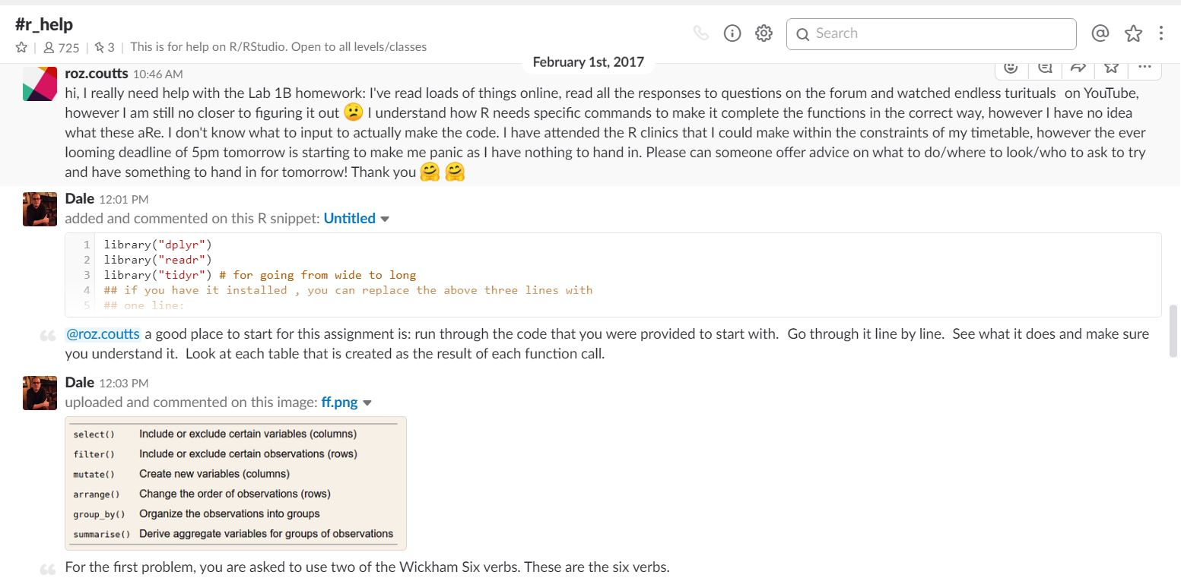
Communication with our students
student1
@student1

Slide 12
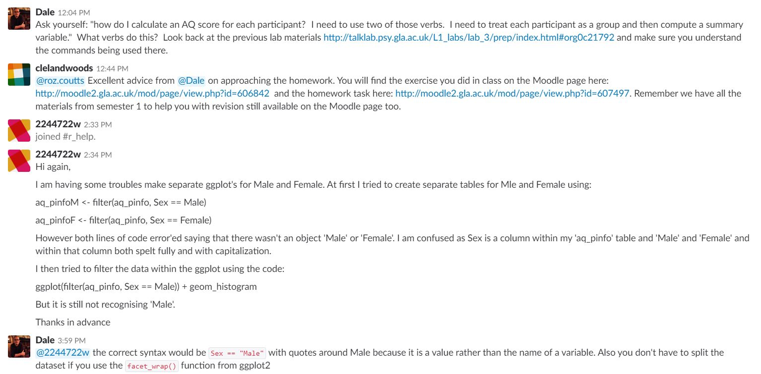
Communication with our students
@student1
student2
student2
@student2

Slide 13
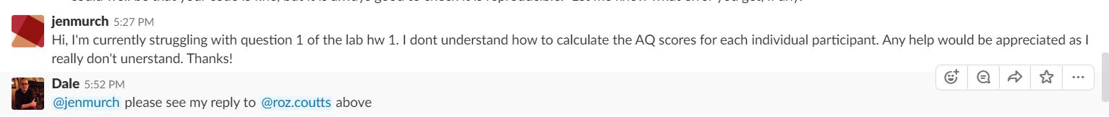
Communication with our students
student1
Similar conversation started by another student…….
student3
@student3
@student2
Students are asking for help
staff refer back to resources on VLE and previous conversations online
Possible for team to provide support in one forum

Slide 14

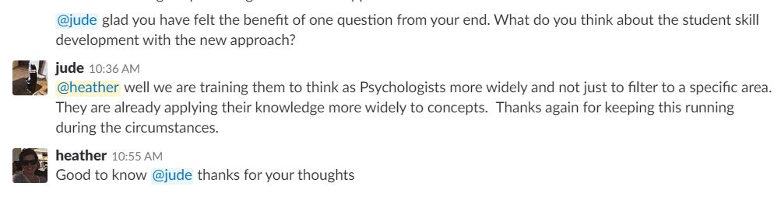
Not just about
Other assessments in line with new approach
Moved away from choice of topic-specific essay questions to one question open to interpretation
Semester 1: How can psychological research help you be a better student?
Semester 2: Reproducible and open science is a hot topic within the scientific community.
What does it mean and why is it important in Psychology?

Slide 15

Challenges Be careful not to overwhelm students with information Staff training and continual CPD Don’t underestimate your students but also don’t overestimate them.

Slide 16
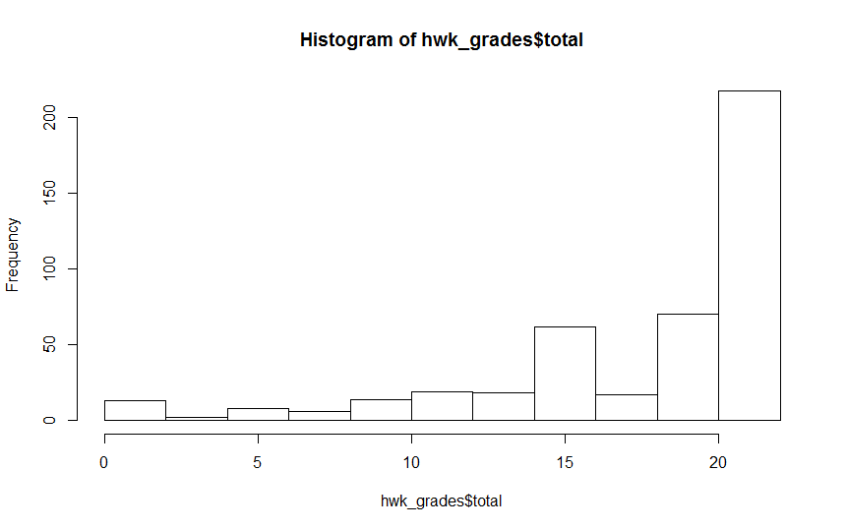
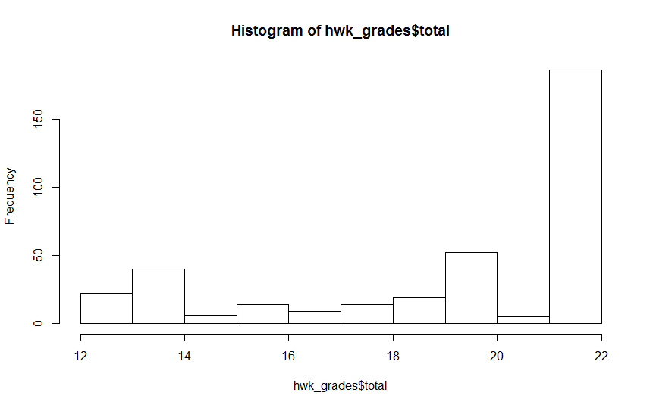
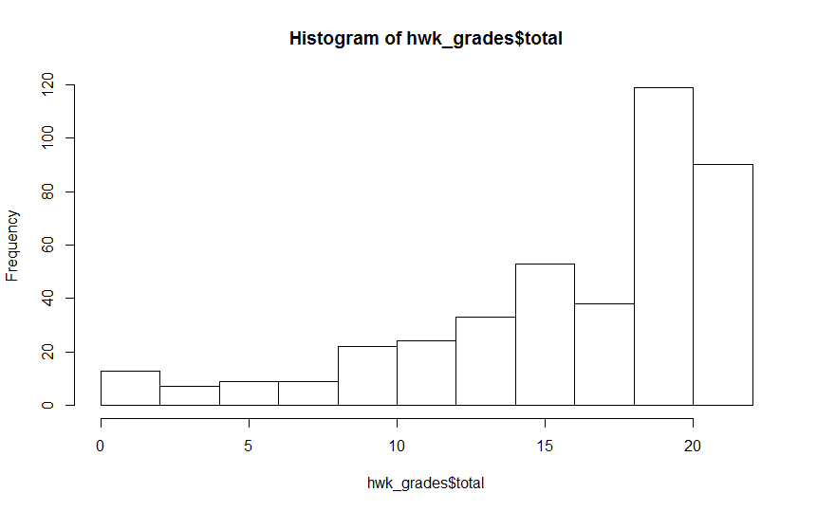
Student grade profile maintained
Lab 1
Lab 3
100 students from class of 529 make merit list!
Lab 2

Slide 17

Student feedback
Students felt supported through staff in-class and online interaction as well as office hours
Link between lectures and practical classes wasn’t clear – keep cohesive
Peer support important
Research led teaching valued

Slide 18
Level 1 student comments
“I was happy that the R homework was marked this semester because that gave me the opportunity to show how much work I put into studying it”
“.. establishing my knowledge base of statistics which through the assessed homework I was able to progress my skills and level of competency”
“I cannot believe how quickly it has gone and how much I have learned and most of all that I now feel much more confident with R (never thought I would say that).”

Slide 19
Level 1 student comments
R isn’t a general fix
2015/16
“If the labs weren't so fast paced and we had time to play with SPSS and really try and understand it.”
2016/17
“I thought it would be helpful if labs perhaps could have included more instruction how to work in R-studio”
Still need to develop curriculum explicitly on skill development such as communication and critical thinking

Slide 20

External examiner feedback
Commended on innovative approach
Other institutions recognize call for development and have acknowledged our innovation
Resources comprehensive and student oriented response

Slide 21
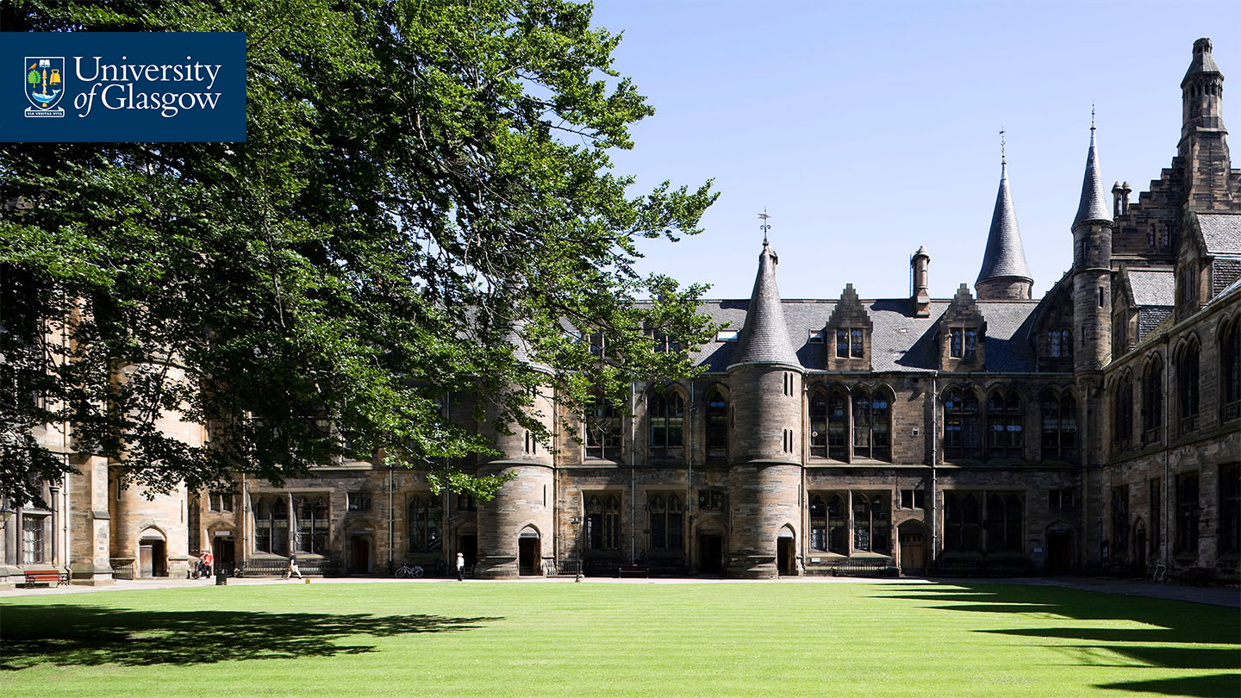
My top tips
Flexible
Clear on rationale
Overview of curriculum – holistic approach

Slide 22




@clelandwoods Heather.Woods@Glasgow.ac.uk
#UofGWorldChangers
@UofGlasgow

